Slide 1
The OpenChain Project
Creating And Maintaining Standards For A Trusted Open Source Supply Chain

Slide 2
Global Codebase Statistics
Over 93% use open source
53% have license compliance issues
81% have security issues
https://www.synopsys.com/blogs/software-security/open-source-trends-ossra-report/ (2022)

Slide 3
Key News Around ISO/IEC 5230:2020

Slide 4
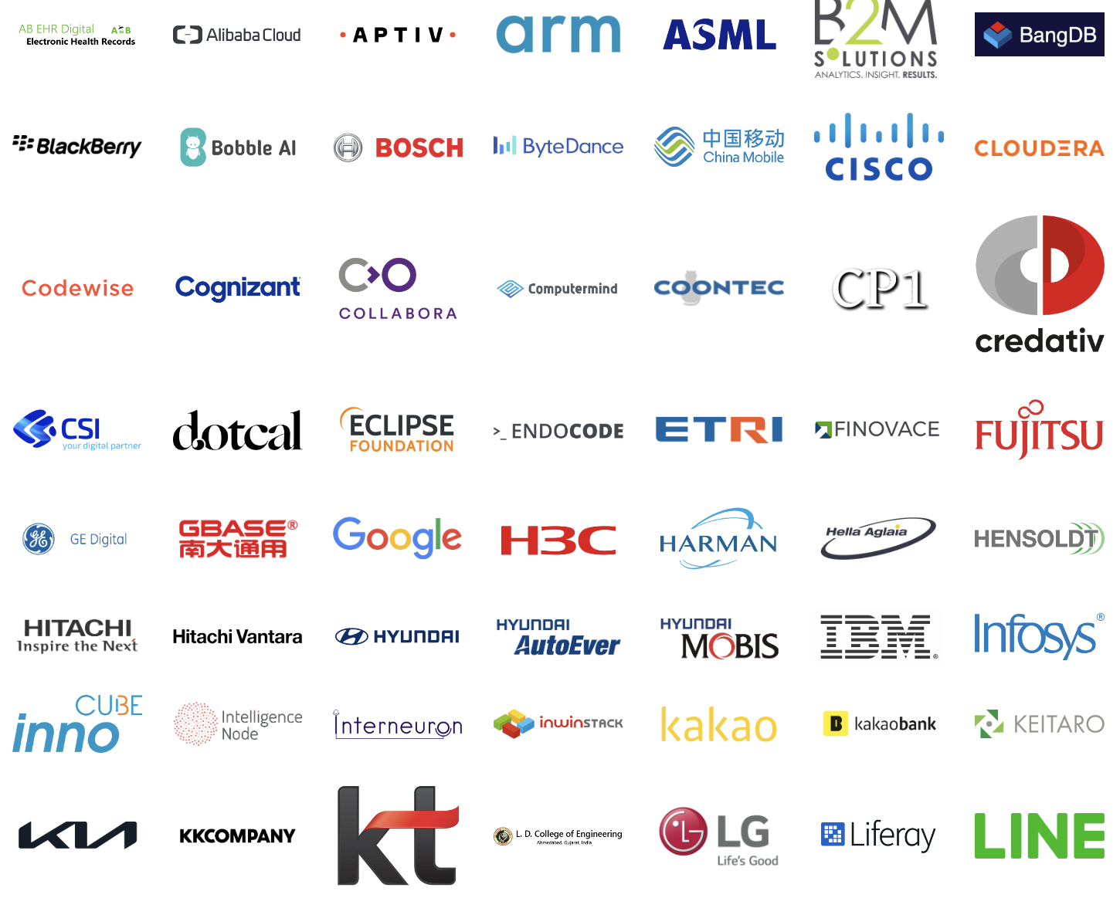
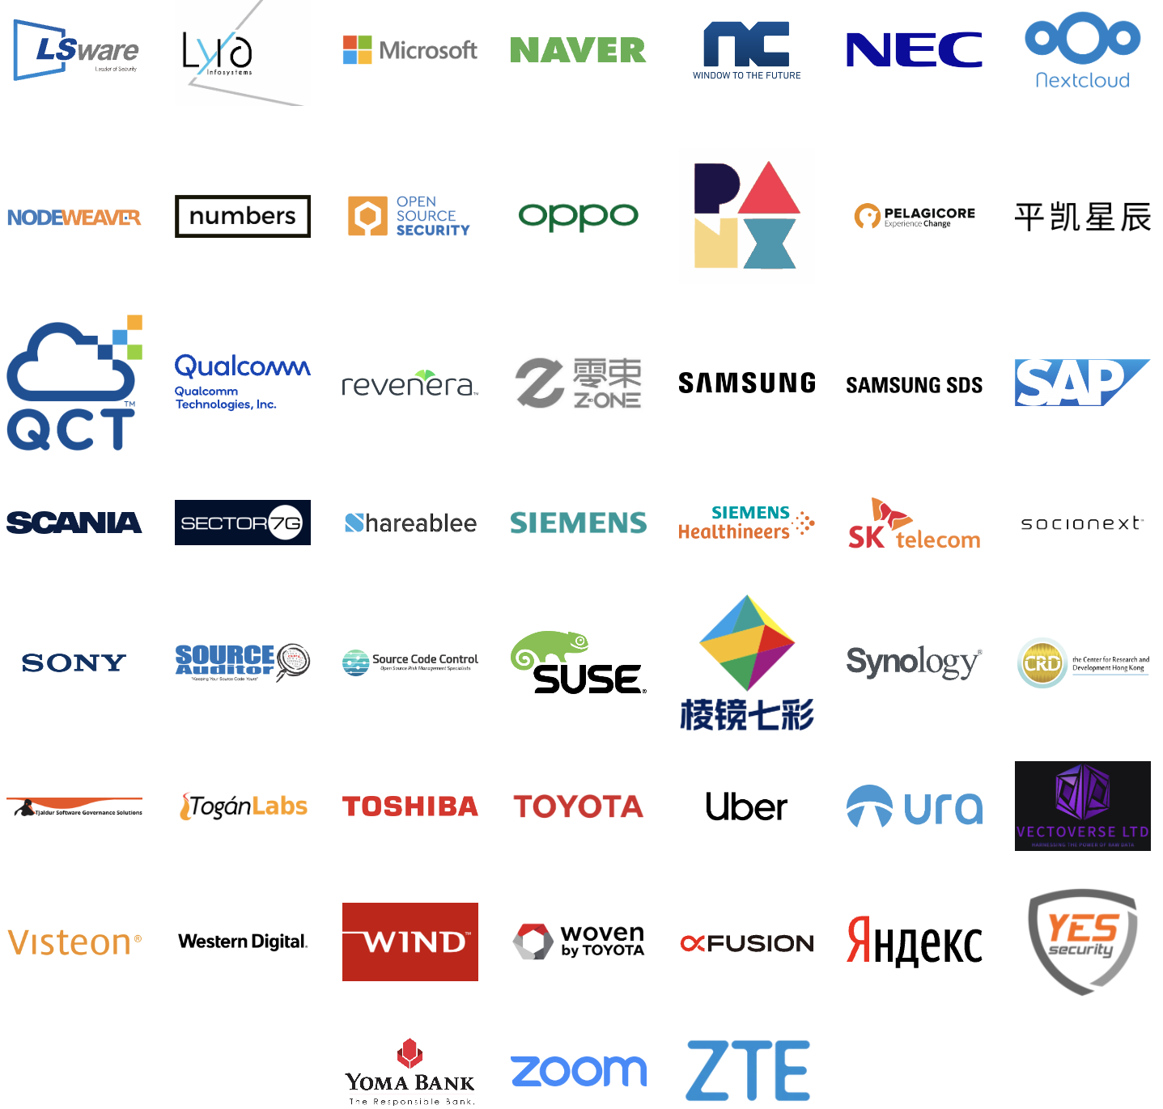
OpenChain Has 108 ISO/IEC 5230 Conformant Orgs Listed On Our Website (totals are higher)
Total conformant numbers far higher. Example: PwC Survey shows 31% of large companies in Germany use or are planning to adopt ISO/IEC 5230.

Slide 5
Recent ISO/IEC 5230 Conformance

Slide 6
12%
decrease in open source license compliance issues since the year OpenChain ISO/IEC 5230 was published
https://www.synopsys.com/blogs/software-security/open-source-trends-ossra-report/ (2022)

Slide 7
31%
of large German companies already use or plan to adopt OpenChain ISO/IEC 5230
https://www.pwc.de/en/digitale-transformation/open-source-software-management-and-compliance/open-source-software-current-trends-and-developments.html

Slide 8
Key News Around ISO/IEC 18974:2023

Slide 9
Conformance Continues With De-Facto Standard

Slide 10
Key Developments
ISO/IEC 18974:2023 is scheduled to be published in November 2023
A major Korean financial institute will be announcing adoption this month.

Slide 11
What Else Is Happening?

Slide 12
Continuing Our Educational Webinars
https://www.openchainproject.org/featured/2023/09/14/webinar-56

Slide 13
Building The Future

Slide 14
The Headline
With the acceptance of ISO/IEC 18974 by ISO, we maintain two ISO standards:
ISO/IEC 5230 – open source license compliance process management
ISO/IEC 18974 – open source security assurance process management
The OpenChain Project has evolved from credibility in open source licence compliance process standardization into having the ability to do various types of open source business process standardization project.
This has strategic implications.
What do we do with our influence and potential?
How do we ensure value for our board members?
Our mission remains building trust in the supply chain (reducing risk, saving money and time)

Slide 15
The Global Community Collaborates
We are working on the proposals for:
OpenChain License Compliance 3.0 (ISO/IEC 5230:2020 next gen)
OpenChain Security Assurance 2.0 (ISO/IEC 18974:2023 next gen)
OpenChain Contribution Process Management 1.0 (name TBD)
OpenChain SBOM Quality Specification 1.0 (Telco Work Group)
These will go before the OpenChain Steering Committee in early December for review.
The Steering Committee will provide formal guidance on where to go next.

Slide 16
Current Versions of OpenChain Standards
Licensing Specification (CURRENT VERSION, 2nd Generation):
https://github.com/OpenChain-Project/License-Compliance-Specification/blob/master/2.1/en/openchainspec-2.1.md
Security Specification (CURRENT VERSION, 1st Generation):
https://github.com/OpenChain-Project/Security-Assurance-Specification/blob/main/Security-Assurance-Specification/1.1/en/openchain-security-specification-1.1.md

Slide 17
Draft Future Versions of Licensing / Security
Licensing Specification (3rd Generation Draft):
https://github.com/OpenChain-Project/License-Compliance-Specification/blob/master/Official/en/3.0/openchain-license-compliance-3.0.md
Security Specification (2nd Generation Draft):
https://github.com/OpenChain-Project/Security-Assurance-Specification/blob/main/Security-Assurance-Specification/2.0/en/openchain-security-specification-2.0.md

Slide 18
Next Steps: Licensing / Security
Open Issues
Both the next generation License Compliance specification and the next generation Security Assurance specification have pre-existing open issues for review:
Licensing: https://github.com/OpenChain-Project/License-Compliance-Specification/issues/
Security: https://github.com/OpenChain-Project/Security-Assurance-Specification/issues/

Slide 19
Proposed OpenChain Contribution Specification
Contribution process community proposal – community editing underway: https://github.com/OpenChain-Project/Contribution-Process-Specification/blob/main/1.0/en/1.0.md
First GitHub Issue: https://github.com/OpenChain-Project/Contribution-Process-Specification/issues/1
Kick-Off Call: https://www.openchainproject.org/news/2023/08/23/contribution-spec-kick-off

Slide 20
SBOM Quality
The OpenChain Telco Work Group has been working on a draft specification to describe a quality Software Bill of Materials: https://github.com/OpenChain-Project/Telco-WG/blob/main/OpenChain%20Telco%20SBOM%20Specification.md
Everyone is welcome to open issues on GitHub for this: https://github.com/OpenChain-Project/Telco-WG/issues
Please note: most of the discussion has happened on the Telco Work Group Mailing List, and they are currently discussing whether the draft spec should actually be an SPDX profile instead: https://lists.openchainproject.org/g/telco/messages

Slide 21
Track All This Work
You can join our monthly North America / Europe and North America / Asia calls every month (two meetings per month): https://www.openchainproject.org/participate
We publish the slides used for every meeting: https://github.com/OpenChain-Project/Meeting-Minutes/tree/main/Slides
We also publish a recording of every meeting: https://www.openchainproject.org/news
You can also join our specification mailing list to follow everything by email: https://lists.openchainproject.org/g/specification

Slide 22
tl;dr: Big Project, Big Community. Plenty Commercial Support Too.

Slide 23
Global Impact January to October 2023
Conformant Companies Listed: 89 > 108 (20.3% increase)
Certifiers: 7 > 13 (85.7% increase)
Service Providers: 24 > 29 (20.8% increase)
Vendors: 11 > 13 (18.2% increase)
Legal Providers: 21 > 24 (14.3% increase)
Standards maintained: 1 > 2 (100% increase)
New specifications under proposal: 1 > 3 (200% increase)

Slide 24
Get Started With Your Adoption and Participation
https://www.openchainproject.org/participate

